Slide 1
Basic concepts of Probability (1)
Md. Ismail Hossain Riday

Slide 2
Probability
Probability is the likeliness/chance of occurring any event(s).
Consider tossing a coin.
What is the chance of it landing heads up?
What is the chance of it landing tails up?

Slide 3
Experiment
A specific action, or
A process, or
A phenomenon that leads to observable outcomes

Slide 4
Experiment
An experiment refers to a specific action, process, or phenomenon that leads to observable outcomes.
For example,
Measuring distance from Dhaka to Chattogram
Tossing a fair coin

Slide 5
Experiment
An experiment refers to a specific action, process, or phenomenon that leads to observable outcomes.
For example,
Measuring distance from Dhaka to Chattogram
Tossing a fair coin

Slide 6
Experiment
An experiment refers to a specific action, process, or phenomenon that leads to observable outcomes.
For example,
Measuring distance from Dhaka to Chattogram
Tossing a fair coin

Slide 7
Types of Experiment
Two types of experiment-
Deterministic: Whose outcome is predictable in advance
Probabilistic/Random: Whose outcome is not predictable

Slide 8
Some examples
Is tossing a coin a random experiment or deterministic experiment?
Ans: Tossing a coin is an experiment. There are two possible outcomes (head or tail). These outcomes are unpredictable before the coin is tossed. Therefore, this is a random experiment.

Slide 9
Some examples
Is drawing a card from well shuffled deck of cards a random experiment or deterministic experiment?
Ans: Drawing a card from a well-shuffled deck of cards is a random experiment. The randomness arises from the uncertainty of which card will be drawn, even though the deck is well-shuffled. The outcome (the specific card drawn) is not predictable beforehand, making it a random event.

Slide 10
Some examples
Is multiplying 4 and 8 on a calculator a random experiment or deterministic experiment?
Ans: Multiplying 4 and 8 on a calculator is a deterministic experiment. In a deterministic experiment, the outcome is certain and predictable based on the given inputs and the rules of the operation. In this case, multiplying 4 and 8 will always result in the same answer: 32. There is no randomness or uncertainty involved in this calculation, making it a deterministic process.

Slide 11
Basic terms
Sample space:

Slide 12
Basic terms
The result of an experiment is known as outcomes
Outcome
Sample space
Head (H)
and
Tail (T)
All possible outcomes
Outcome

Slide 13
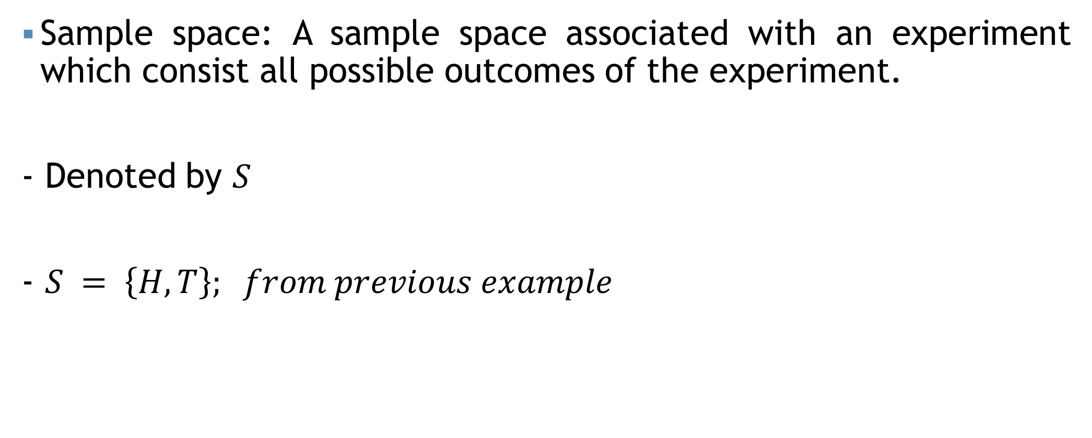
Basic terms
Sample space: A sample space associated with an experiment which consist all possible outcomes of the experiment.
- Denoted by $S$
- $S = \left\{H, T\right\}; from previous example$

Slide 14
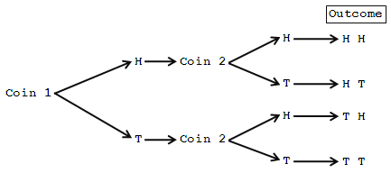
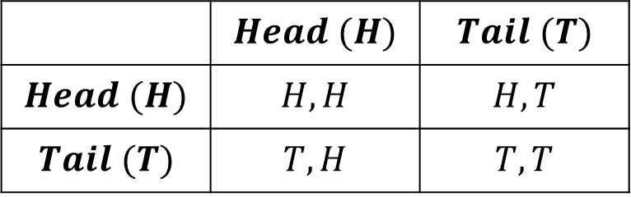
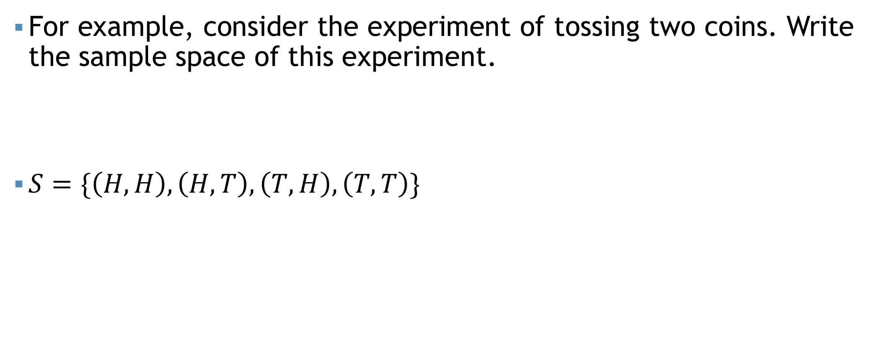
Basic terms
For example, consider the experiment of tossing two coins. Write the sample space of this experiment.
$S=\{\left(H,H\right),\left(H,T\right),\left(T,H\right),\left(T,T\right)\}$
 | $$Head (H)$$ | $$Tail (T)$$
$$Head (H)$$ | $$H,H$$ | $$H,T$$
$$Tail (T)$$ | $$T,H$$ | $$T,T$$

Slide 15
Basic terms
For example, consider the experiment of throwing two dices. Write the sample space of this experiment.
 | 1 | 2 | 3 | 4 | 5 | 6
1 | 1,1 | 1,2 | 1,3 | 1,4 | 1,5 | 1,6
2 | 2,1 | 2,2 | 2,3 | 2,4 | 2,5 | 2,6
3 | 3,1 | 3,2 | 3,3 | 3,4 | 3,5 | 3,6
4 | 4,1 | 4,2 | 4,3 | 4,4 | 4,5 | 4,6
5 | 5,1 | 5,2 | 5,3 | 5,4 | 5,5 | 5,6
6 | 6,1 | 6,2 | 6,3 | 6,4 | 6,5 | 6,6

Slide 16
Basic terms
Event:

Slide 17


Basic terms
Is this a random experiment?
Yes, sir!
Can you write the sample
space?
$$S=\left\{1,2,3,4,5,6\right\}$$
Split the odd number…
An Event
$$A=\left\{1,3,5\right\}$$

Slide 18
Basic terms
Event: Any subset of the sample space

Slide 19
Basic terms
Union of events $\left(A∪B\right)$
Union of events (𝐴∪𝐵)
Intersection of events $(A∩B)$
Intersection of events (A∩𝐵)
Complement of an event $\left(\overline{A} or A′\right)$
Complement of an event (𝐴 ̅ 𝑜𝑟 𝐴′)
Exclusive event
Exhaustive event
Equally likely event
Event: Any subset of the sample space
Different types of events:
Exclusive events: Two events are called mutually exclusive if both the events cannot occur simultaneously in a single trial. In other words, if one of those events occurs, the other event will not occur.
Exhaustive events: Exhaustive events are those, which includes all possible outcomes.
Equally likely events: The events of a random experiment are called equally likely if the chance of occurring those events are all equal.

Slide 20
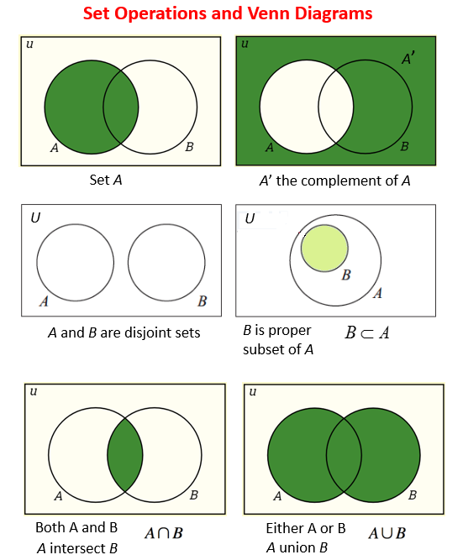

Basic terms
$$A∪\left(B∪C\right)=\left(A∪B\right)∪C$$
$$A∩\left(B∩C\right)=\left(A∩B\right)∩C$$
$$A∪\left(B∩C\right)=\left(A∪B\right)∩\left(A∪C\right)$$
$$A∩\left(B∪C\right)=\left(A∩B\right)∪\left(A∩C\right)$$
$$A∩\overline{B}=A−\overline{B}$$
$$\overline{\left(A∪B\right)}=\overline{A}∩\overline{B}$$

Slide 21
Approaches of assigning probability
At first we identify the sample space S of the random experiment.
We then define our favorable event and assign probability to the event using one of the following 3 basic approaches-
Classical
Frequency
Subjective

Slide 22





Classical approach
$$P\left(Event\right)=\frac{Number of occurance/outcome in the event}{Total number of outcomes in the sample space}$$
Assumption-
Equally likely outcome
Mutually exclusive outcome
Mutually exhaustive outcome
$$P\left(A\right)=\frac{3}{6}$$
$$A=\left\{2, 4, 6\right\}$$
$$S=\left\{1, 2, 3, 4, 5, 6\right\}$$
$$P\left(B\right)=\frac{3}{6}$$
$$B=\left\{1, 3, 5\right\}$$

Slide 23
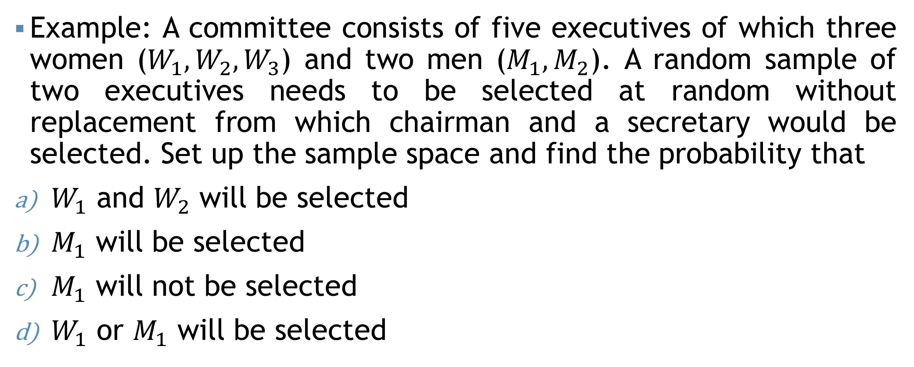
Classical approach
Example: A committee consists of five executives of which three women ($W_{1}, W_{2}, W_{3}$) and two men ($M_{1}, M_{2}$). A random sample of two executives needs to be selected at random without replacement from which chairman and a secretary would be selected. Set up the sample space and find the probability that
$W_{1}$ and $W_{2}$ will be selected
$M_{1}$ will be selected
$M_{1}$ will not be selected
$W_{1}$ or $M_{1}$ will be selected

Slide 24

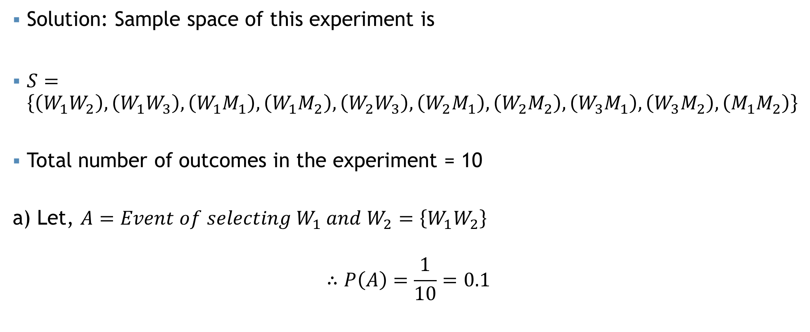
Classical approach
a) $W_{1}$ and $W_{2}$ will be selected
Solution: Sample space of this experiment is
$S=\left\{\left(W_{1}W_{2}\right),\left(W_{1}W_{3}\right),\left(W_{1}M_{1}\right),\left(W_{1}M_{2}\right),\left(W_{2}W_{3}\right),\left(W_{2}M_{1}\right),\left(W_{2}M_{2}\right),\left(W_{3}M_{1}\right),\left(W_{3}M_{2}\right),\left(M_{1}M_{2}\right)\right\}$
Total number of outcomes in the experiment = 10
a) Let, $A=Event of selecting W_{1} and W_{2}=\left\{W_{1}W_{2}\right\}$
$$∴P\left(A\right)=\frac{1}{10}=0.1$$

Slide 25

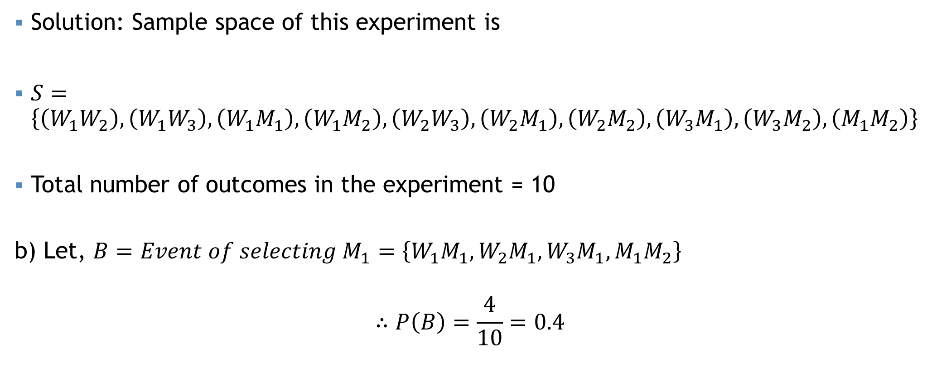
Classical approach
b) $M_{1}$ will be selected
Solution: Sample space of this experiment is
$S=\left\{\left(W_{1}W_{2}\right),\left(W_{1}W_{3}\right),\left(W_{1}M_{1}\right),\left(W_{1}M_{2}\right),\left(W_{2}W_{3}\right),\left(W_{2}M_{1}\right),\left(W_{2}M_{2}\right),\left(W_{3}M_{1}\right),\left(W_{3}M_{2}\right),\left(M_{1}M_{2}\right)\right\}$
Total number of outcomes in the experiment = 10
b) Let, $B=Event of selecting M_{1}=\left\{W_{1}M_{1},W_{2}M_{1},W_{3}M_{1},M_{1}M_{2}\right\}$
$$∴P\left(B\right)=\frac{4}{10}=0.4$$

Slide 26


Classical approach
c) $M_{1}$ will not be selected
Solution: Sample space of this experiment is
$S=\left\{\left(W_{1}W_{2}\right),\left(W_{1}W_{3}\right),\left(W_{1}M_{1}\right),\left(W_{1}M_{2}\right),\left(W_{2}W_{3}\right),\left(W_{2}M_{1}\right),\left(W_{2}M_{2}\right),\left(W_{3}M_{1}\right),\left(W_{3}M_{2}\right),\left(M_{1}M_{2}\right)\right\}$
Total number of outcomes in the experiment = 10
c) Let, $B=Event of selecting M_{1}=\left\{W_{1}M_{1},W_{2}M_{1},W_{3}M_{1},M_{1}M_{2}\right\}$
$$∴P\left(\overline{B}\right)=1−P\left(B\right)=1−\frac{4}{10}=0.6$$

Slide 27

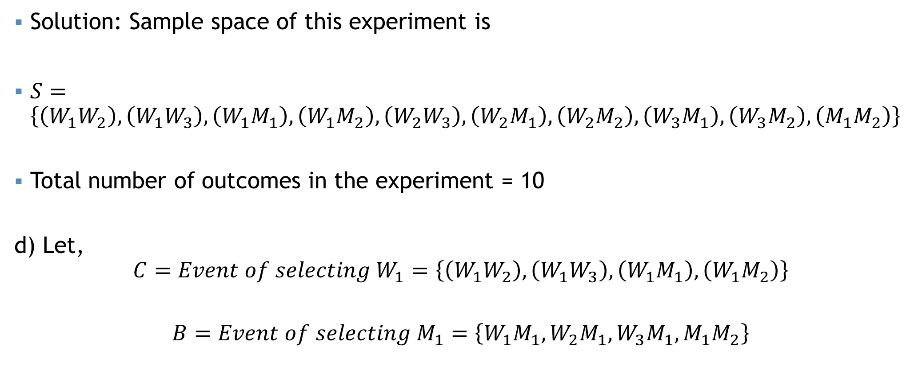
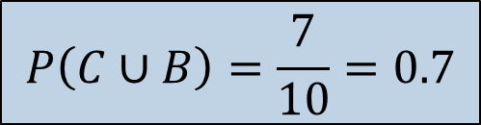
Classical approach
d) $W_{1} or M_{1}$ will be selected
Solution: Sample space of this experiment is
$S=\left\{\left(W_{1}W_{2}\right),\left(W_{1}W_{3}\right),\left(W_{1}M_{1}\right),\left(W_{1}M_{2}\right),\left(W_{2}W_{3}\right),\left(W_{2}M_{1}\right),\left(W_{2}M_{2}\right),\left(W_{3}M_{1}\right),\left(W_{3}M_{2}\right),\left(M_{1}M_{2}\right)\right\}$
Total number of outcomes in the experiment = 10
d) Let,
$$C=Event of selecting W_{1}=\left\{\left(W_{1}W_{2}\right),\left(W_{1}W_{3}\right),\left(W_{1}M_{1}\right),\left(W_{1}M_{2}\right)\right\}$$
$$B=Event of selecting M_{1}=\left\{W_{1}M_{1},W_{2}M_{1},W_{3}M_{1},M_{1}M_{2}\right\}$$
$$C or B=C∪B=\left\{\left(W_{1}W_{2}\right),\left(W_{1}W_{3}\right),\left(W_{1}M_{1}\right),\left(W_{1}M_{2}\right),W_{2}M_{1},W_{3}M_{1},M_{1}M_{2}\right\}$$
$$P\left(C∪B\right)=\frac{7}{10}=0.7$$

Slide 28
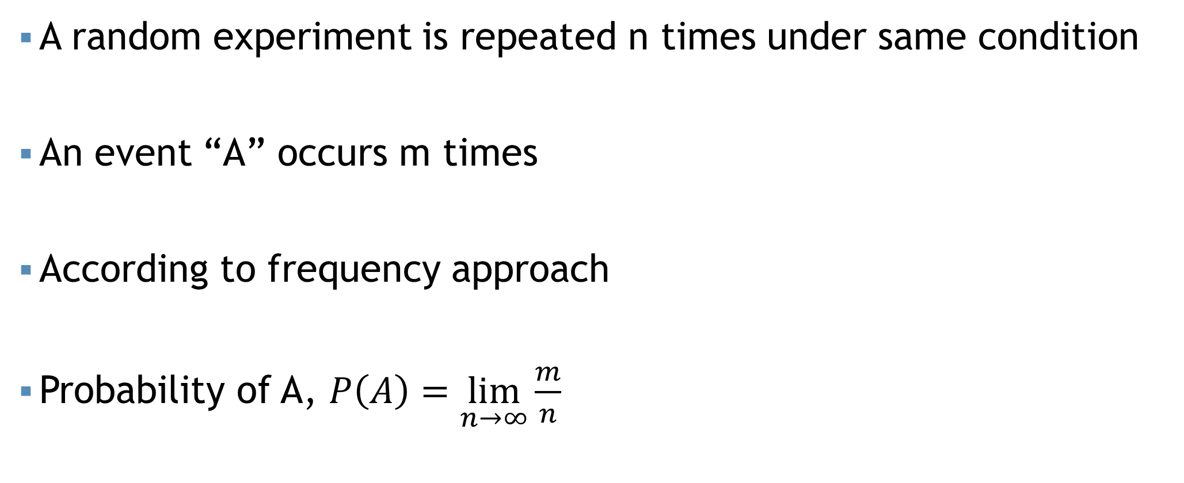
Frequency approach
A random experiment is repeated n times under same condition
An event “A” occurs m times
According to frequency approach
Probability of A, $P\left(A\right)=\lim_{n→∞}{\frac{m}{n}}$

Slide 29
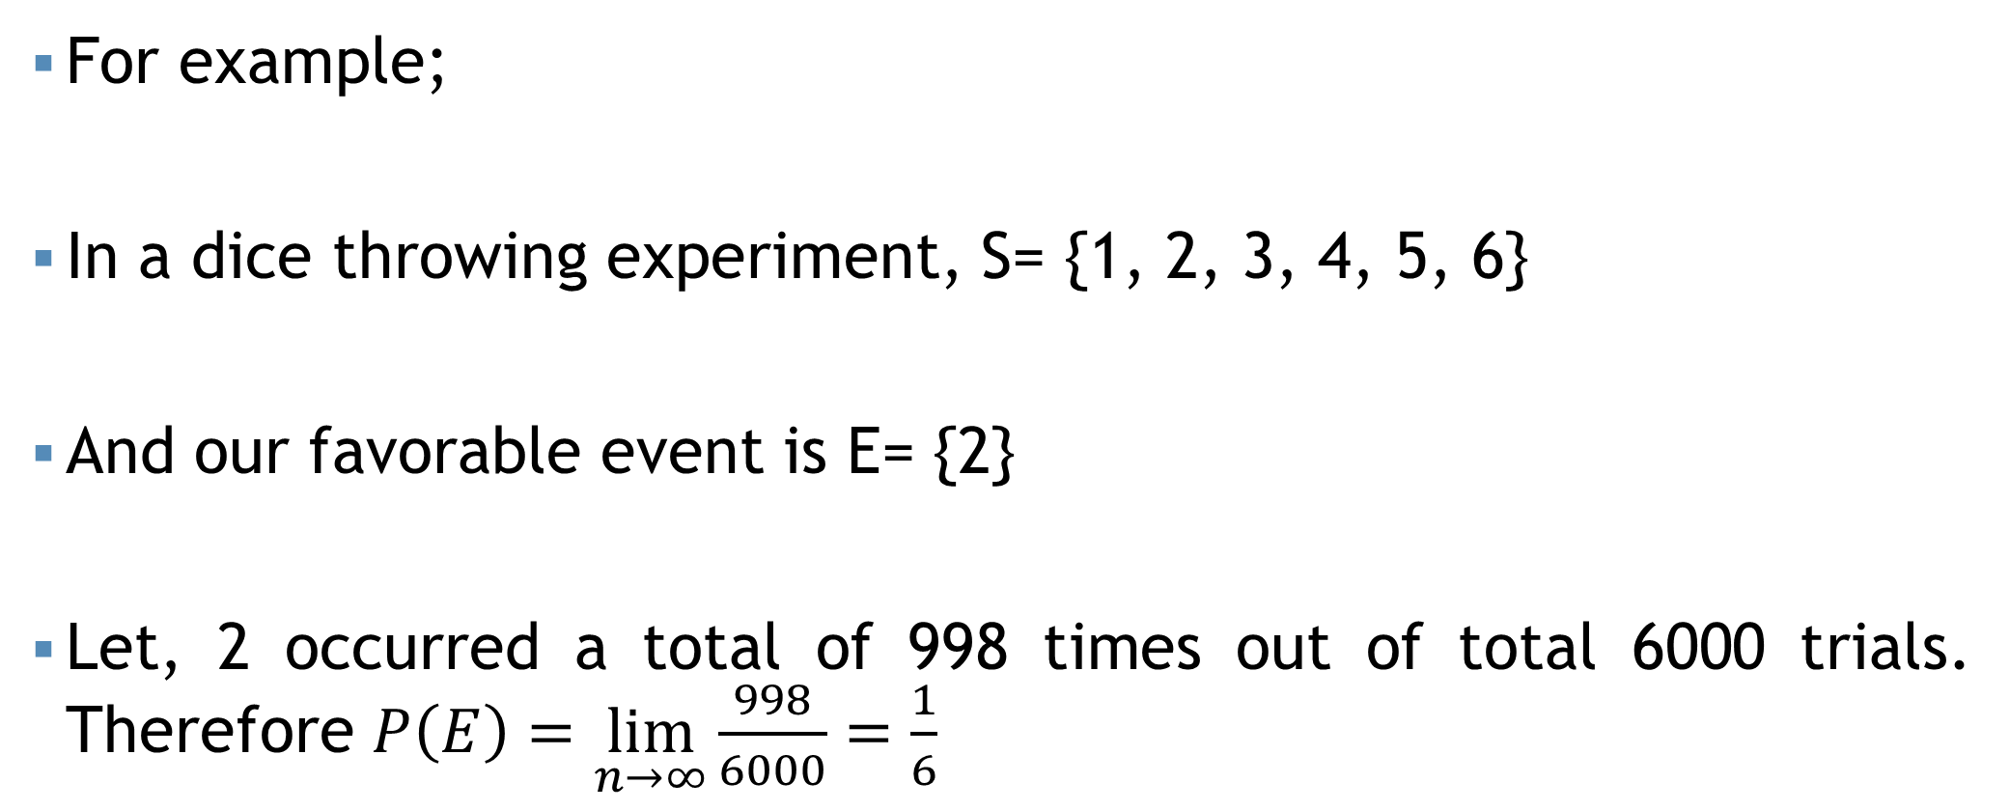
Frequency approach
For example;
In a dice throwing experiment, S= {1, 2, 3, 4, 5, 6}
And our favorable event is E= {2}
Let, 2 occurred a total of 998 times out of total 6000 trials. Therefore $P\left(E\right)=\lim_{n→∞}{\frac{998}{6000}=\frac{1}{6}}$

Slide 30
Subjective approach
Based on the judgement (personal experience, prior information and belief etc.), one can assign probability to an event E of a random experiment.
For example; on a day of summer someone made a statement on probability that rain will occur on that day is .70, based on his previous experience.

Slide 31
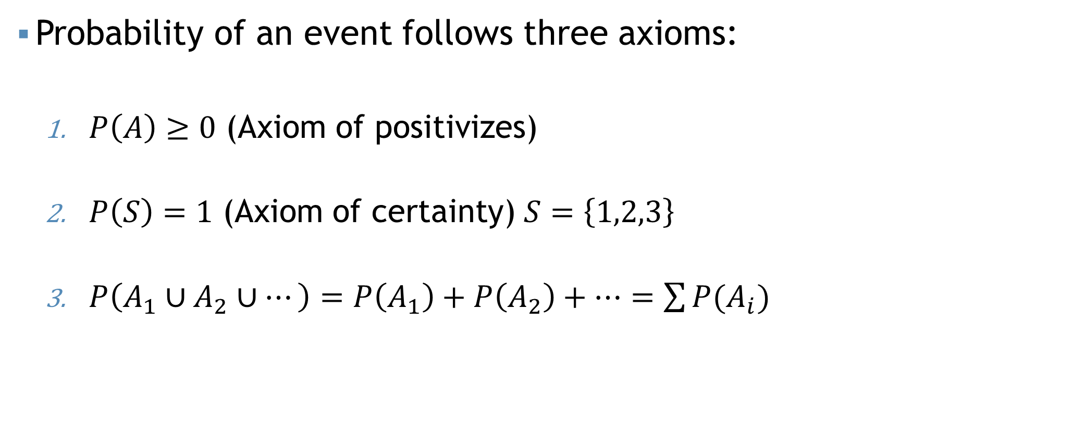
Axioms of probability
Probability of an event follows three axioms:
$P\left(A\right)≥0$ (Axiom of positivizes)
$P\left(S\right)=1$ (Axiom of certainty) $S=\left\{1,2,3\right\}$
$P\left(A_{1}∪A_{2}∪…\right)=P\left(A_{1}\right)+P\left(A_{2}\right)+…=\sum{P(A_{i})}$

Slide 32
With and Without Replacement

Slide 33
With and Without Replacement

Slide 34
With and Without Replacement

Slide 35
With and Without Replacement

Slide 36
With and Without Replacement
If the elements of a sample are drawn randomly one by one and after each draw the element is returned to the population = With Replacement
With Replacement

Slide 37
With and Without Replacement

Slide 38
With and Without Replacement

Slide 39
With and Without Replacement
If the elements of a sample are drawn randomly one by one and after each draw the element is not returned to the population = With Out Replacement
Without Replacement

Slide 40
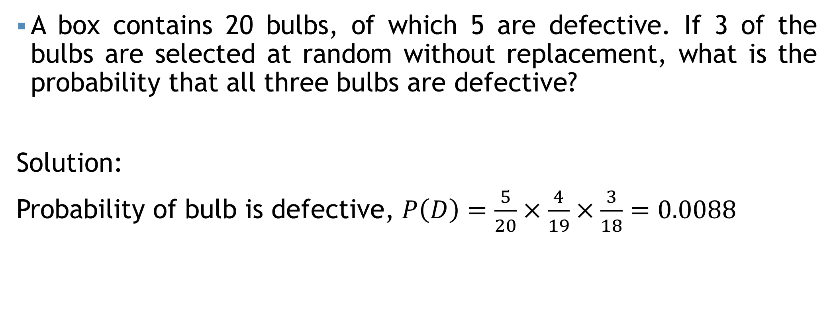
With and Without Replacement
A box contains 20 bulbs, of which 5 are defective. If 3 of the bulbs are selected at random without replacement, what is the probability that all three bulbs are defective?
Solution:
Probability of bulb is defective, $P\left(D\right)=\frac{5}{20}×\frac{4}{19}×\frac{3}{18}=0.0088$

Slide 41
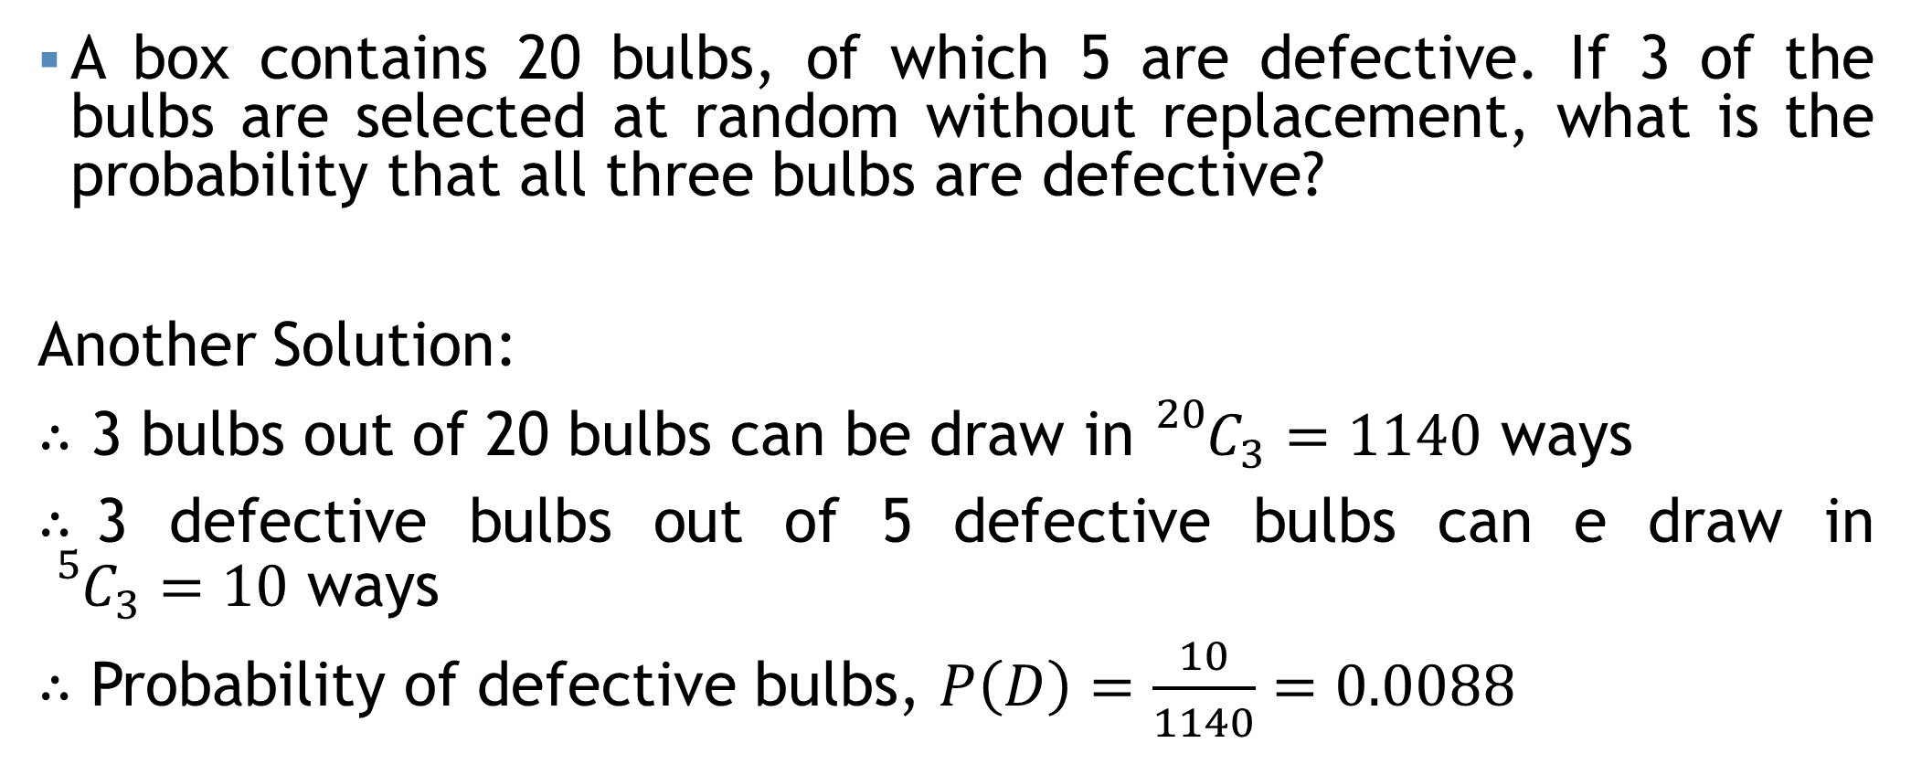
With and Without Replacement
A box contains 20 bulbs, of which 5 are defective. If 3 of the bulbs are selected at random without replacement, what is the probability that all three bulbs are defective?
Another Solution:
$∴$ 3 bulbs out of 20 bulbs can be draw in ${}_{}^{20}{C_{3}=1140}$ ways
$∴$3 defective bulbs out of 5 defective bulbs can e draw in ${}_{}^{5}{C_{3}=10}$ ways
$∴$ Probability of defective bulbs, $P\left(D\right)=\frac{10}{1140}=0.0088$

Slide 42
Mathematical exercise
To access additional mathematical problems, please refer to the PDF lecture notes.

Slide 43
Thank You

